Slide 1

15/03/2026
FMI{CODES} 2026
PF
When there is
too much going on

Slide 2

15/03/2026
FMI{CODES} 2026
PF
People often lose track of their surroundings

Slide 3




15/03/2026
FMI{CODES} 2026
PF
Here is our
DEMO

Slide 4
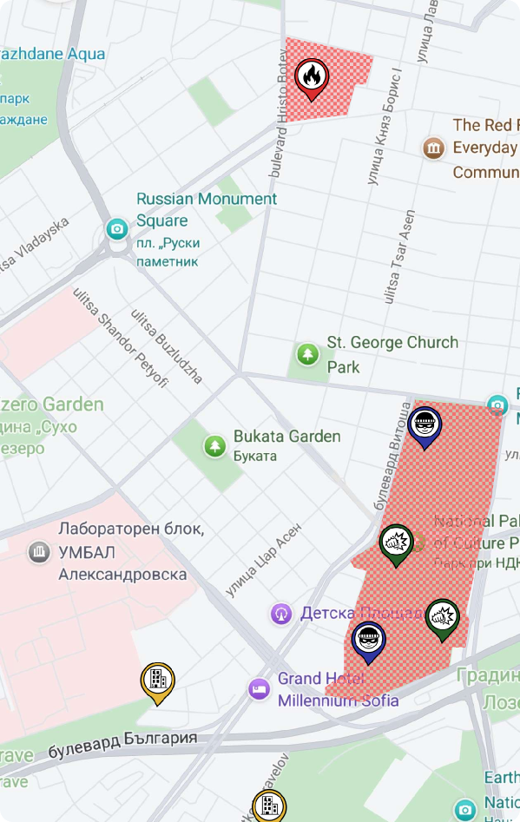
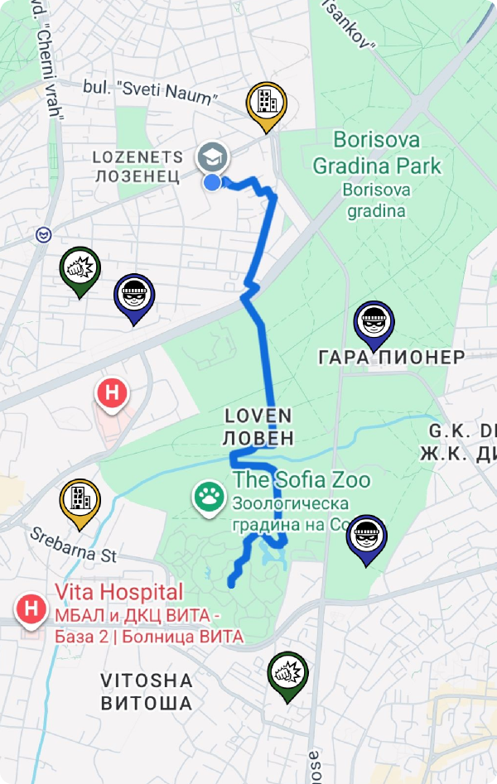
15/03/2026
FMI{CODES} 2026
PF
Danger Zones
Safe Route
Area History

Slide 5
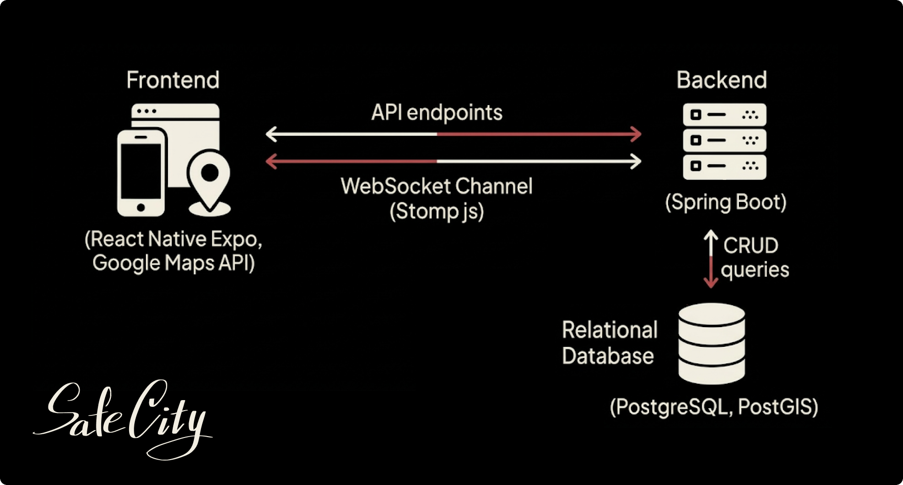
15/03/2026
FMI{CODES} 2026
PF

Slide 6

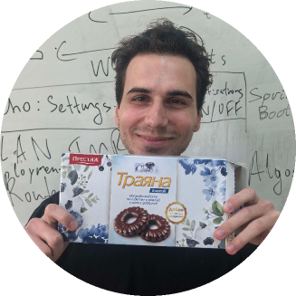
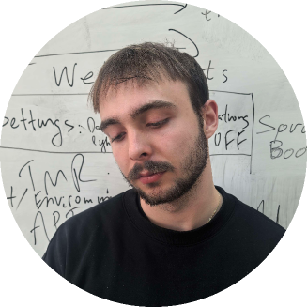
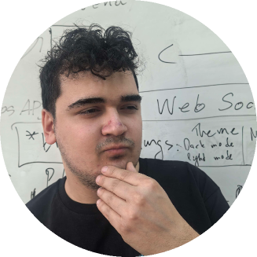
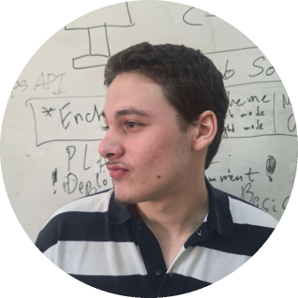
15/03/2026
FMI{CODES} 2026
PF
Thank you!
TO P. PEEV

